Slide 1
APPLICATION OF MICROTESTER FOR DETECTION OF LOW MICROBIAL CONTAMINATION Oliver Reichart Katalin Szakmár

Slide 2
Classical microbiological methods
Long incubation time (1-4 days)
The applicability, reliability and test prices of the methods are concentration-dependent:
High concentration: dilution and colony counting in the range of 30-300 cfu/ml.
Low concentration: Membrane filtration

Slide 3
The Microtester method
The energy source of the growth is the biological oxidation which results in a reduction in the environment.
Due to the oxygen depletion and the production of reducing compounds the redox-potential of the nutrient medium changes.
The redox-potential of the medium is a well measurable parameter which could be used for the determination of the microbial multiplication.

Slide 4
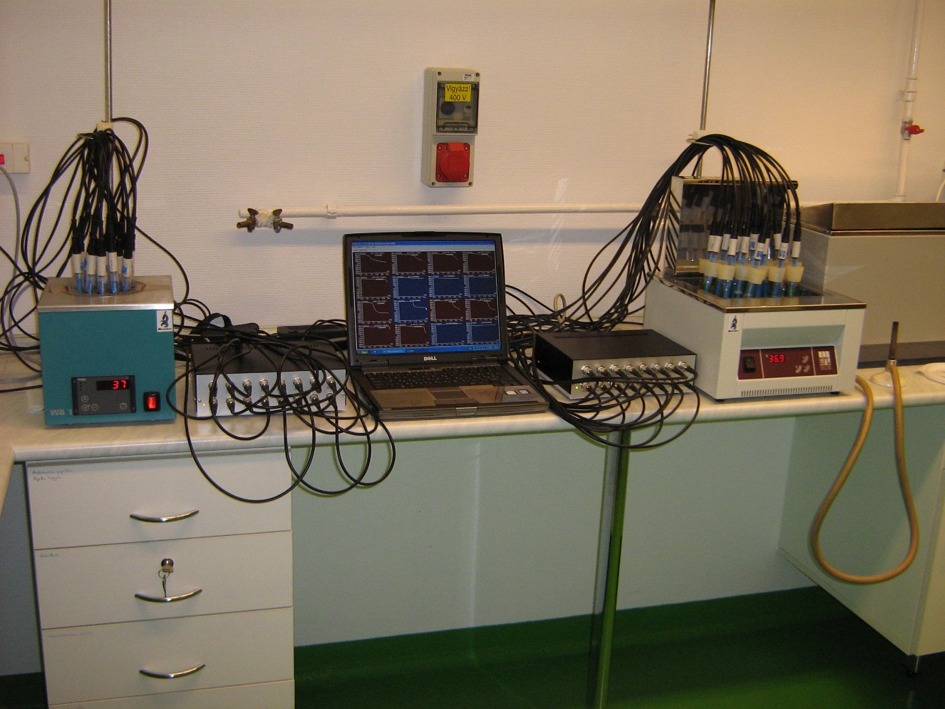
MicroTester System, 32 Channels
Water baths
Test cells
Measuring modules
Computer,
Monitor

Slide 5
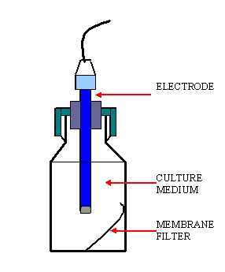
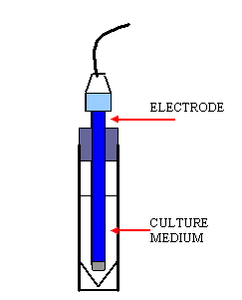
Direct test cells

Slide 6
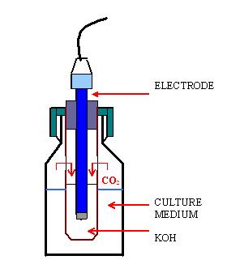
Indirect test-cell

Slide 7
Redox-curves of several bacteria

Slide 8
Characteristics of the redox-curves

Slide 9
Characteristics of the redox-curves
Detection criterion (DC)
The detection criterion is the critical rate of the change of redox-potential (dE/dt, the slope of the redox curve) which is significantly differing from the random fluctuation and could be ascribed to the multiplication of the microbes. (e.g. DC = |dE/dt| = 0.5 mV/min).
Detection time (TTD)
The detection time (TTD) is that moment when the absolute value of the rate of redox potential change in the measuring-cell exceeds the detection criterion. |dE/dt| ≥ DC mV/min).
As the critical rate of the redox potential decrease needs a well-defined critical cell number (Nc = 10⁷ cfu/ml) the detection time depends on the initial microbial count, N₀.

Slide 10
Positive detection
In the inoculated medium the microbes after the lag phase start to multiply. Due to their metabolism the redox-potential decreases in the test cell.
After a time (depending on the inoculum size) the rate of decrease exceeds the detection criterion. The system gives a TTD value which refers to the presence of multiplying microorganisms (in about 10⁶-10⁷ cfu/ml concentration).
Keeping on the redox-measurement appears a typical redox-curve characterizing on the microbe or microbial group growing in the test cell.
As a result of the multiplication we get a suspension of 10⁷-10⁸ cfu/ml with visual turbidity.

Slide 11
False positive detection in selective medium
In case of massive inoculation (i.e. from the surface of solid medium with a loop) the initial microbe concentration in the test cell could exceed the value of 10⁷-10⁸ cfu/ml and causes visual turbidity.
The exo-enzymes and metabolites of the inoculum start immediately to reduce the redox-potential of the medium which could result in TTD detection in the initial concave section of the redox-curve.
As the multiplication is inhibited by the selective medium the characterising convex section of the redox-curve does not evolve.

Slide 12
Redox curves in cetrimide broth

Slide 13
Effect of the inoculum size on the redox-curves
TTD for the redox-potential measurement is: |ΔE/Δ t|>1mV/min

Slide 14
Effect of the initial cell concentration on TTD

Slide 15
Calibration curves
Strict linear relationship exists between the logarithm of the viable count of the test cell inoculum, log N(c) and the detection time (TTD) which is represented by the calibration curve.
The equation of the calibration curve makes possible to calculate the viable cell count on the base of TTD in a very wide range:
log N(c) = A · TTD + B
The calibration curves refer on the test cell and the microbial contamination of the sample is calculated by the software automatically.

Slide 16
MPN calibration curves
MPN calibration curve is applied when the previously constructed calibration curve cannot be taken. In this case, the redox potential measurement could be combined with the MPN method and the software makes possible the on-line determination the most probable microbial count and the calibration curve.
From the sample the usual dilution series is prepared up to a dilution which is free of microbe. In case of low cell numbers apply membrane filtering.
Place the membranes into the measuring cells and record the redox curves.

Slide 17
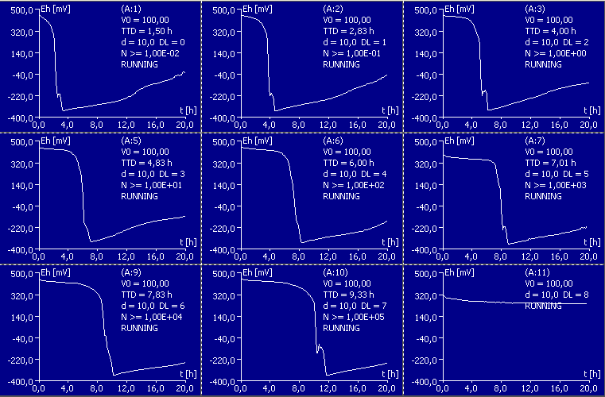
Redox-curves for the E. coli calibration

Slide 18
Determination of the calibration curve
Based on the last dilution level still showing multiplication (TTD), the most probable cell-number of the undiluted (most concentrated) sample, MPN(0) is determined automatically by the program.
With the knowledge of MPN(0) and TTD values belonging to the several dilutions, the software calculates the equation of the log MPN calibration.
Having determined the microbial contamination of the sample with a classical reference method and inputting the result, the system automatically recalculates the MPN calibration to logN calibration.

Slide 19
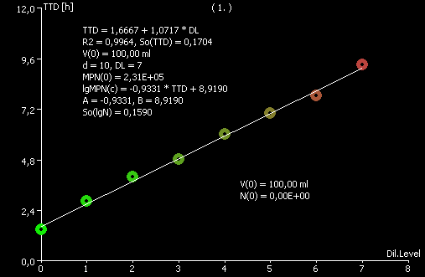
MPN calibration

Slide 20
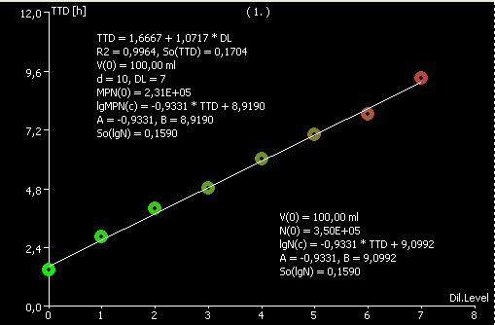
MPN and logN calibration

Slide 21
Calibration curve

Slide 22
Redox-curves. How long to measure?
If we have got TTD value it is proposed to continue the measurement until the redox curve is taking shape.
Having no TTD it is proposed to measure until the estimated microbial count in the test cell (calculated by the calibration curve) drops below 1/100, logN(c) < -2.

Slide 23
Time to „detection no microbe”, TTDN
In the test cell
logN(c) ≤ -2
logN(c) = A·TTD + B
TTD = [logN(c) – B] / A
A = -0.933 h⁻¹ B = 9.099
Time to detection no microbe: TTDN ≥ 11.2 h

Slide 24
Time to „detection no microbe”, TTDN
Microbe/medium | Medium | Calibration |  | TTDN
 | (ml) | A (h⁻¹) | B | (h)
E. coli | 15 | -0,627 | 8,307 | 16,4
BBL 44 °C | 50 | -0,854 | 10,260 | 14,4
Cb. freundii | 15 | -0,420 | 7,449 | 22,5
BBL 37 °C | 50 | -0,667 | 10,332 | 18,5
Ps. aeruginosa | 15 | -0,595 | 9,456 | 19,2
Cetrimide 37 °C | 50 | -0,513 | 11,111 | 25,6
Entc. faecalis | 15 | -0,406 | 7,645 | 23,7
Azide 37 °C | 50 | -0,480 | 9,482 | 23,9

Slide 25
Application for low microbial contamination
Membrane filtering
Microbe concentration of the sample: N(0) cfu/ml
Volume of the filtered sample: V(0) ml
Detection limit in the test cell: N(c)min = 1 cfu/test cell
Detection limit of the sample: N(0)min = N(c)min/V(0)
N(0)min = 1/V(0) cfu/ml
Do not forget:
In the low microbial concentration range the probability of the detection is highly affected by the test volume.

Slide 26
Linearity of membrane filtering

Slide 27
Detection of microbial contamination
Sampling and testing the product
To find the defective unit and detect the contamination
Distribution of micro-organisms in the product
Contagious distribution (б²>µ)
Sporadic occurrence of defective units
Main problem is to find the defective units
Random distribution (б²=µ)
Main problem is to detect the low microbial count
Basic assumption: Even one viable cell results in positive test.

Slide 28
Effect of the test volume on the detection
Legends
N_{s} : average microbe-concentration of the sample (cfu/ml)
V_{s} : sample-volume (ml)
n : sample size
V_{i} : The total volume tested V_{i} = V_{s} · n
N_{i} : Inoculated total cell number in the all tests (cfu)
N_{i} = N_{s} ·V_{i}

Slide 29
Probability of positive test
Zero tolerance, positive test is not allowed
The probability of n negative test:
The probability of minimum 1 positive test:

Slide 30
Comparison of the classical and redox methods
At a given microbial concentration the effectiveness of the testing depends on the filtered volume: V_{i} = V_{s} ·n
Example for mineral water testing: Vs = 250 ml/sample
Classical membrane filtration,
1 membrane for 3 samples
1 Petri dish for 1 membrane = 3 samples
Microtester method with normal loading
1 membrane for 4 samples
1 test cell for 5 membranes = 20 samples

Slide 31
Probability of positive test

Slide 32
Probability of positive test

Slide 33
Presence/Absence tests 1.
72 bottles tested for Coliform (09 Aug 2005)
Method of Laboratory, Tergitol agar, 24 Petri dishes
Membrane filtering 3 x 250 ml with 1 filter.
Placing 1 filter in a Petri dish
One Petri dish represents 3 bottles All negative
Detection threshold: 1 microbe/750ml
Redox potential method, BBL broth, 6 Channels,
Membrane filtering 3 x 250 ml with 1 filter.
Placing 4 filters in a test cell.
One test cell represents 12 bottles All negative
Detection threshold: 1 microbe/3000ml
Positive control:
1 ml Citrobacter freundii suspension (logN = 3.66)

Slide 34
Advantages of the redox method in the evaluation of membrane filtration
The time requirement of the redox-potential technique is significantly lower than that of the classical nutrient methods.
While the classical methods use only 1 membrane in 1 Petri dish the redox-potential method makes possible to evaluate even 5 or more filters in one test cell. That means not only a 5 times lower detection limit of microbes but results in a remarkable cost reduction as well.

